Slide 1
CS 0007: Introduction to Java
Lecture 19
Nathan Ong
University of Pittsburgh
November 15, 2016

Slide 2
Main Portions of OOP
Building a class
Determining inter-class relationships

Slide 3
Class Components
Class-level/Instance Variables
Methods
Constructor(s)

Slide 4
Inter-class Relationships
Building a single class is useless. It needs to be used in context.
There are two main relationships between classes
  Sub/Super class
  Ownership

Slide 5
Modeling a Problem
“Joe’s Automotive Shop services foreign cars, and specializes in servicing cars made by Mercedes, Porsche, and BMW. When a customer brings a car to the shop, the manager gets the customer’s name, address, and telephone number. Then the manager determines the make, model, and year of the car, and gives the customer a service quote. The service quote shows the estimated parts charges, estimated labor charges, sales tax, and total estimated charges.”
Source: Starting Out with Java: From Control Structures through Objects by Tony Gaddis

Slide 6
Class Overview
address foreign cars Porsche
BMW Joe’s Automotive Shop sales tax
car make service quote
cars manager shop
customer Mercedes telephone number
estimated labor charges model total estimated charges
estimated parts charges name year

Slide 7
The Object Class
Let us examine the API for the highest class.
toString() looks interesting. “It is recommended that all subclasses override this method.”

Slide 8
What Is toString()?
It provides a String representation of an object
It should be descriptive, not just what type it is, but what is contained within it.

Slide 9
Functional Responsibility
How do we determine which class(es) should have which functions?
You need to ask: Who’s state is needed or changing?

Slide 10
Hard example
Using the automotive shop example, we have four classes, Shop, Customer, Car, and Service Quote.
Who deals with car alterations?
  Shop?
  Mechanic?
  Car?

Slide 11
Advanced Input and Simple Exception Handling

Slide 12
Scanners
Scanners actually have an inconveniently annoying flaw
Some of you may have already encountered it

Slide 13
Scanner Issue
import java.util.Scanner;
public class ScannerAttempt
{
public static void main(String[] args)
{
Scanner scan = new Scanner(System.in);
System.out.println("Enter your age");
int age = scan.nextInt();
System.out.println("Enter your name");
String name = scan.nextLine();
System.out.println(name + " is " + age +
" years old.");
}//end method main
}//End class ScannerAttempt

Slide 14
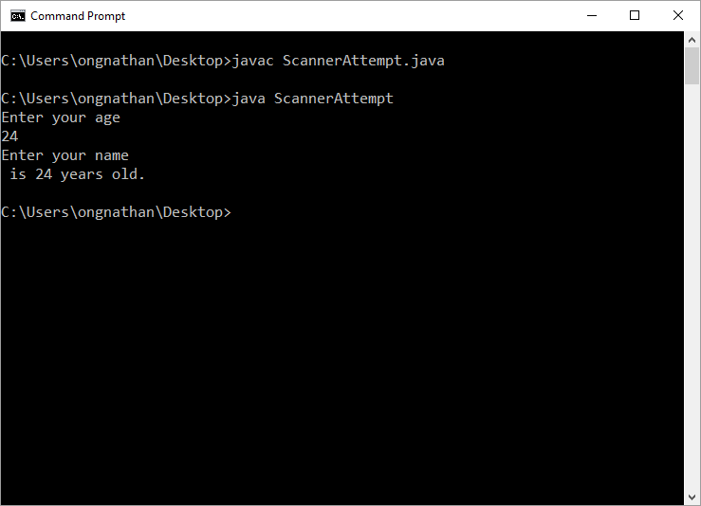
I couldn’t even enter my name before it finished

Slide 15
Long Story Short
Scanner has a buffering quirk. When scanning for a token (an item like boolean, int) that is not a line, the scanner reads up to the new line character, but does not consume it.
When you call nextLine(), it sees the new line, assumes it is done reading, and returns an empty String.

Slide 16
What Should Happen Then?
There are two ways of dealing with it
Call nextLine() twice
Use the appropriate classes and parse the input

Slide 17
A Reminder
The act of receiving input is called reading
Relevant classes that do reading are Readers

Slide 18
A Re-examination
System.in
An InputStream
If we examine the API, InputStreams can only read bytes. Not very helpful.
What could we try?

Slide 19
InputStreamReader
Now we can read characters, but having to combine all the characters is difficult
Why don’t we use the suggestion from the API?

Slide 20
BufferedReader
This thankfully allows us to read full lines of input
The input needs to be processed depending on your needs
Let us first learn how to use BufferedReader correctly

Slide 21
Example
import java.io.BufferedReader;
import java.io.InputStreamReader;
public class BRExample
{
public static void main(String[] args)
{
BufferedReader reader = new
BufferedReader(new
InputStreamReader(System.in));
String line = reader.readLine();
System.out.println(line +
" is what you wrote.");
}//end method main
}//End class BRExample

Slide 22
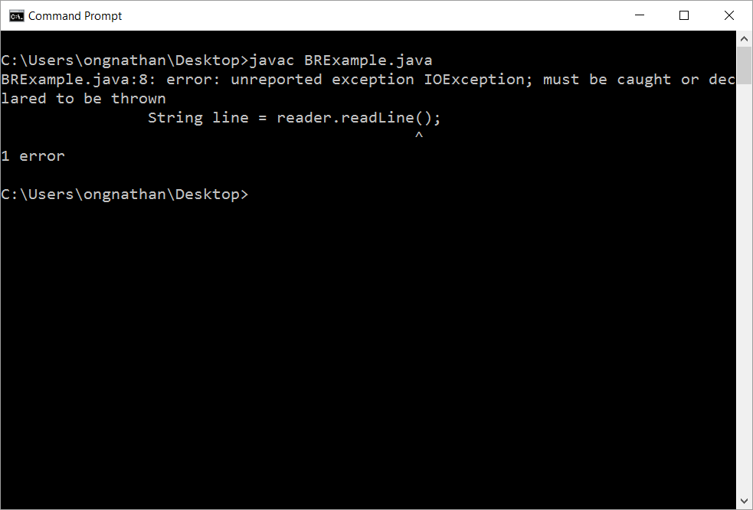

Slide 23
Exceptions
An exception is an event meant to disrupt the flow of execution
To throw an exception is to see an exception being raised
To catch an exception is to acknowledge a thrown exception
You probably have already encountered some while debugging your code
We will focus on two of three types, which are more common

Slide 24
Exception Types
Checked
  Exceptions that need to have a contingency plan should the exception arise
  These stop the compiler from running
  Example: IOException
Unchecked
  Exceptions that tend to indicate the program has a flaw during its execution
  These stop the program in the middle of execution
  Example: ArrayIndexOutOfBoundsException

Slide 25
Dealing with Exceptions
Checked
  try, catch, finally
Unchecked
  Fix your program code

Slide 26
Example
import java.io.BufferedReader;
import java.io.InputStreamReader;
public class BRExample
{
public static void main(String[] args)
{
String line = "";
System.out.println("Type something!");
try
{
BufferedReader reader = new
BufferedReader(new
InputStreamReader(System.in));
line = reader.readLine();
}
catch (IOException e)
{
e.printStackTrace();
}
System.out.println(line + " is what you wrote.");
}//end method main
}//End class BRExample

Slide 27
Keywords in Context
Everything inside the try block indicates the section of code that may throw exceptions
Inside the catch’s parentheses is the expected exception to process, and the name given to it (usually ‘e’)
Inside the catch block indicates the section of code that should be executed if the exception is caught

Slide 28
Some FAQ
How do I know when an exception is thrown?
  Check the API for relevant methods
How do I know which exception is thrown?
  Check the API
How much code should I surround with try?
  Only as much as you need
  Note that scope applies here as well
Can I catch multiple exceptions?
  Yes, you can use several catch blocks
  We’ll see an example soon

Slide 29
Converting Strings into Useful Primitives
Scanner gave us useful methods like nextInt() or nextDouble(). We can do the same with BufferedReader, but not directly.
We need to take another trip to the API, specifically for the classes that back the primitives.
Let’s look at Integer

Slide 30
Example
import java.io.BufferedReader;
import java.io.InputStreamReader;
public class Converter
{
public static int convertToInt(String line)
{
try
{
return Integer.parseInt(line);
}
catch (NumberFormatException e)
{
//??
}
}//end method main
}//End class BRExample

